Slide 1
Multiagent Simulation of Team Training
Richard Yang
Advisors: Dr. David Pynadath, Dr. Ning Wang
July 25, 2016
Notes:
Good afternoon everyone,
My name is Richard Yang and I’m an REU intern with the Social Simulation at ICT.
Today

Slide 2
Tutoring for Team Training
Simulate human social interaction in groups
My project:
Design autonomous agents that can work together
Design learning models of how agents change their behavior through experience
Simulate how training and feedback strategies interact with agents and learning models
Overall goal: see how virtual agents work together, and how it reflects in the real world
Notes:
To start off, one of the research areas of ICT is to simulate human social interaction in groups.
So this summer, my project has three goals. The first is to design virtual autonomous agents can work together in a team, and putting them in a scenario where teamwork is important.
Then we look at how these agents learn, by training them and providing feedback. And to model how agents change their behavior as a result.
Finally, to look at how different training and feedback strategies will affect them. Such as training agents through multiple scenarios or with different teammates.
So my overall goal is to build a simulation to study agent personalities, learning models, and training strategies. Which then we can see how it reflects in the real world with real people.

Slide 3








Simulating Social Interactions
ICT’s PsychSim toolkit
Agents
Actions
World Dynamics
Reward
Notes:
This summer, I worked with ICT’s PsychSim toolkit in my project. PsychSim is a tool to model interactions and decision making in multiagent systems.
Inside a PsychSim world, there exists these entities that are capable of making decisions, and they’re called Agents.
In order to make decisions, Agents have features that represent their current state in the world.
And they also have actions, which result in changing the world in someway after the action is taken.
So agents can have multiple actions, but they take actions based on an incentive for their behavior, or we call that the reward function.
With these models, the agents can perform autonomously in their environment.

Slide 4


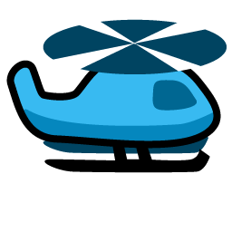

Scenario Setup
Similar to a game of capture the flag
Set in 2D grid system
Primary Agents:
Soldiers
Enemies
Supporting Agents:
Helicopters
Bases
Notes:
I designed a scenario that is modeled after a game of capture the flag set in a 2-dimensional world.
There are four types of agents in the scenario. The goal of

Slide 5
Scenario Setup
Features
(X, Y)
(Goal X, Goal Y)
Actions:
Move <Direction>
Reward:
Minimize distance to goal
Maximize distance to enemy
Win if goal is reached
Features
(X, Y)
Actions:
Move <Direction>
Reward:
Minimize distance to Soldier
Minimize distance to Helicopter
Win if Soldier is captured
Soldiers
Enemies
Features
None
Actions:
Deploy Helicopter
Reward:
Maximize distance between Soldier and Enemy
Minimize costs of deployment
Features
(X, Y)
Deployment Flag
Deployment Cost
Actions:
Move <Direction>
Reward:
Maximize distance between Soldier and Enemy
Bases
Helicopters
Notes:
I designed a scenario that is modeled after a game of capture the flag set in a 2-dimensional world. There are four types of agents in the scenario.
Our team (blue) consists of Soldiers, Helicopters, and Bases working together against an enemy (red) agent.
The soldier agent is represented by its coordinate position and is given the location of the flag it needs to capture. It can move in any of the four directions, and it’s objective is to reach the flag and be as far away from the enemy agent as possible. The soldier agent can win the game by capturing the flag.
The enemy agent is the same representation of a soldier agent, but on the other team. Its goal is to chase down any agents from the blue team.
The base agent serves as a “command center” for the game. When it sees a soldier in trouble, it has the option of deploying one of its helicopters to distract the enemy away from the soldier agent’s location. However, deploying the helicopter has a cost associated, and it’s the base’s job to determine the appropriate time for deployment.
The helicopter agent is the distractor. It can only move it is deployed by the base, and its goal is to keep the enemy away from the soldier.

Slide 6
Scenario Setup
A Soldier agent can only win with the help from the Base and Helicopter agents
The behavior of the agents are affected by the weights on their reward functions
Results in agents having personalities, which result in good or bad teamwork
Notes:
Soldier agents are the only way for the blue team to win. In certain situations, the soldier agent can only win if it works together with the Base and Helicopter.
The decision making behavior of the agents can be changed by modifying their goals. By making minor changes to their goals, we can essentially give agents a personality. Which could be recklessness in terms of the soldier, or greed in terms of the base.
These slight modifications can drastically change the outcome of the scenario, which I will demonstrate on the next slide.

Slide 7
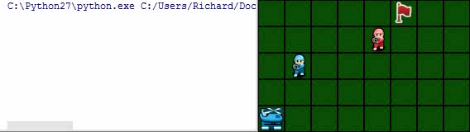
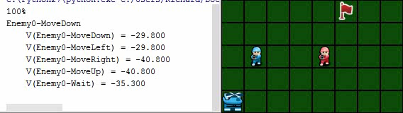
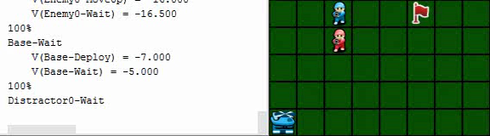
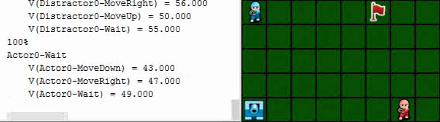
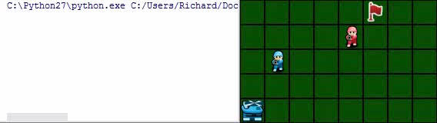
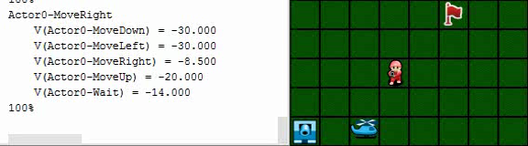
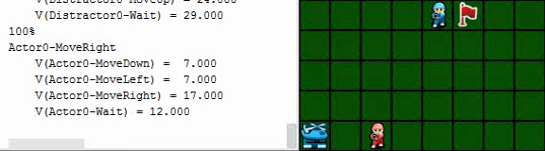
Scenario Performances
Base is too greedy, refuses to deploy helicopter due to cost
Soldier is too concerned with getting captured, and never reaches goal
Soldier is too aggressive wanting to reach the goal, and runs straight into the enemy
Demonstration of successful teamwork. Base deploys a helicopter that effectively draws enemy away

Slide 8
Future Goals
Train the agents to perform better after receiving feedback
Take the trained agents and put them in other scenarios to see how they perform
Create a virtual tutor that provides feedback on agents’ performance
Notes:
I have a couple of goals that I’m still working to accomplish for my project.
The first is to try different training strategies to see what works.
Then I can take the trained agents and put them in other scenarios to see how they perform
Finally, a stretch goal is to build a virtual tutor that can intelligently select the right strategy dynamically.

Slide 9


